Slide 1
What is Data Mining

Slide 2
What is Data Mining?
You may have heard about this term in various contexts.
Is it about techniques? Is it about analyzing large scale data? What do you think?
Is it clear to you what the differences are between data mining, machine learning, data science, and big data analytics?

Slide 3
Alternative Names
Knowledge Discovery in Databases
Knowledge Extraction
Data/Pattern Analysis
Data Archeology
Data Dredging
Information Harvesting

Slide 4
Explosive Growth of Data
By 2025 ~100 zettabytes of data will be generated worldwide.
1 zettabyte = 1000 exabytes
1 exabyte = 1000 petabyte
1 petabyte = 1000 terabytes
1 zettabyte = 1 trillion terabytes
E.g., Tweets: ~6,000 generated per sec
200 billion Tweets generated per year!

Slide 5
Explosive Growth of Data
“We are drowning in data, but starving for knowledge.”
*Inspired from quote by John Naisbitt in 1982: “We are drowning in information but starved for knowledge.”

Slide 6
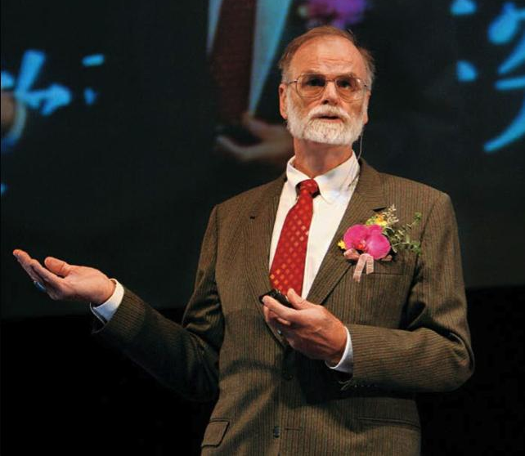
The Fourth Paradigm of Science
First Paradigm: Empirical/Experimental Science (~1600)
Second Paradigm: Theoretical Science (1600~1950s)
Third Paradigm: Computational Science (1950s-1990s)
Fourth Paradigm: Data-intensive Science called “eScience” (2000s ~)
Use of data-driven discovery
Closely related to “data science”
Data mining is the major challenge
Jim Gray (1944 - 2007)
Computer Scientist
Turing Award Winner (1998)

Slide 7
What is Data Mining?
“Knowledge Discovery from Data”

Slide 8
“Knowledge Discovery from Data”
Jiawei Han: Extraction of interesting patterns or knowledge from huge amounts of data.

Slide 9
“Knowledge Discovery from Data”
Jiawei Han: Extraction of interesting (non-trivial, implicit, previously unknown and potentially useful) patterns or knowledge from huge amounts of data.

Slide 10
“Knowledge Discovery from Data”
Sunita Sarawagi: Process of semi-automatically analyzing large databases to find patterns that are:
valid: hold on new data with some certainty
novel: non-obvious to the system
useful: should be possible to act on the item
understandable: humans should be able to interpret the pattern

Slide 11
“Knowledge Discovery from Data”
Jiawei Han: Extraction of interesting (non-trivial, implicit, previously unknown and potentially useful) patterns or knowledge from huge amounts of data.
Sunita Sarawagi: Process of semi-automatically analyzing large databases to find patterns that are:
valid: hold on new data with some certainty
novel: non-obvious to the system
useful: should be possible to act on the item
understandable: humans should be able to interpret the pattern

Slide 12
“Knowledge Discovery from Data”
Vipin Kumar: Exploration and analysis, by automatic or semi-automatic means, of large quantities of data in order to discover meaningful patterns.

Slide 13
“Knowledge Discovery from Data”
Jiawei Han: Extraction of interesting (non-trivial, implicit, previously unknown and potentially useful) patterns or knowledge from huge amounts of data.
Sunita Sarawagi: Process of semi-automatically analyzing large databases to find patterns that are:
valid: hold on new data with some certainty
novel: non-obvious to the system
useful: should be possible to act on the item
understandable: humans should be able to interpret the pattern
Vipin Kumar: Exploration and analysis, by automatic or semi-automatic means, of large quantities of data in order to discover meaningful patterns.

Slide 14
Not Everything is Data Mining!
Looking up a phone number in phone directory. Data mining?
- Tan, Steinbach, Kumar, Introduction to Data Mining

Slide 15
Not Everything is Data Mining!
Looking up a phone number in phone directory. Data mining?
Query a search engine for pages that contain “Amazon.” Data mining?
- Tan, Steinbach, Kumar, Introduction to Data Mining

Slide 16
Not Everything is Data Mining!
Looking up a phone number in phone directory. Data mining?
Query a search engine for pages that contain “Amazon.” Data mining?
(Deductive) Expert systems. Data mining?
- Tan, Steinbach, Kumar, Introduction to Data Mining

Slide 17


School of Information, University of Michigan
Qiaozhu Mei
School of Information
All Content © Presenter

